Slide 1
An Introduction to Lifespan Development
Chapter 1
MVT V. d

Slide 2
Learning Objectives
LO1-1 What is lifespan development?
LO 1-2 What are some of the basic influences on human development?
LO 1-3 What are the key issues in the field of development?
LO 1-4 Which theoretical perspectives have guided lifespan development?
LO 1-5 What role do theories and hypotheses play in the study of development?
LO 1-6 How are developmental research studies conducted?
LO 1-7 What are some of the ethical issues regarding psychological research?
Notes:
Explain: These are the learning objectives we will consider as we begin our journey into the field of lifespan development.

Slide 3
AN ORIENTATION TO DEVELOPMENT ACROSS THE LIFESPAN

Slide 4
What is Lifespan Development?
LIFESPAN DEVELOPMENT
Field of study that examines patterns of growth, change, and stability in human behavior throughout the lifespan.
Change
Remain
Grow
MVT
Notes:
Remind students that LD involves study of ways in which we stay the same, as well as ways we grow and change over time.
Ask: In what ways is a person different when he is one week old and 100 years old? Now ask, how is this person the same?

Slide 5
Specialists in Lifespan Development
And the Nursing Intersection
Focus
Physical development – Main Stream Nursing
  Biological processes – Main Stream Nursing
  Genetic endowment – Specialized (but not for long)
Cognitive development – Psychiatric, Geriatric, Pediatric
Personality Development – Psychiatric, School
Social development – Social Work, School, Pediatric
MVT

Slide 6
Assumptions about Developmental Study
Scientific approach that focuses on continuous human development
Every period of life contains potential for growth and decline in abilities
Process of development persists throughout every part of people's lives
Neither heredity nor environment alone can account for the full range of human develop
MVT
Notes:
Scientific, developmental approach that focuses on human development
Neither heredity nor environment alone can account for the full range of human develop
Development is continuing process throughout lifespan
Every period of life contains potential for growth and decline in abilities
Process of development persists throughout every part of people's lives

Slide 7
The Scope of the Field: Major Topical Areas
Physical development
Cognitive development
Personality & social development
CNS
Inner
Outer
Body
MVT
Notes:
See table 1-1
If YOU were being studied today, what would be investigated in each of these areas?
Think about the youngest person you know. What things would be investigated about them?
Now think about the oldest person you have ever met (or read about), how would each area be studied?

Slide 8
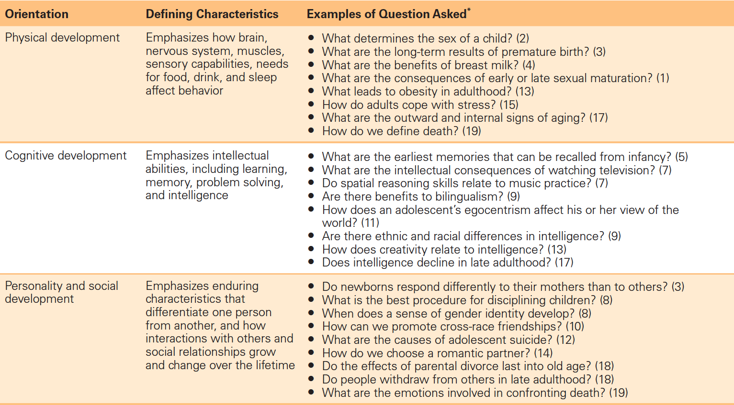
Table 1-1. Approaches to Lifespan Development
Emphasizes how brain,
Nervous system, sensory capabilities, muscles, skeletal & physical needs affect behavior
CNS
Body
Inner
Outer
MVT
Notes:
*Numbers in parentheses indicate in which chapter the question is addressed.

Slide 9
The Scope of the Field:
Age and Range Differences
Prenatal period
Infancy and toddlerhood
Middle childhood
Adolescence
Emerging adulthood
Young adulthood
Middle adulthood
Late adulthood
Paint a Word Picture
Take a few minutes to quickly write down a phrase that describes each developmental period.
Share with your classmates.
MVT
Notes:
Ask: Are your conceptions of each of these broad age ranges the same as, similar to, or different than the authors. For example, if you are 19, do you still consider yourself an adolescent? How might your personal conceptions influence your interpretation of different age ranges presented in the text?
Ask: What role do individual differences play in the timing of events in people's life? Can you give an example?

Slide 10
Cultural Factors and Developmental Diversity
Broad factors
Orientation toward individualism or collectivism
Finer differences
Ethnicity
Race
Socioeconomic status
Gender
Cohort
Even Finer differences
Geek vs. Jock
Sprinkle vs. Pour
MVT
Notes:
See How Cultural, Ethnicity, and Race Influence Development on page7
Define:
INDIVIUDALISM
COLLECTIVISM
RACE
ETHNIC GROUP and ETHNICITY

Slide 11
What the heck is a cohort?
Cohort (biology) a taxonomic term in biology
Cohort (educational group) students working through the same academic curriculum
Cohort (military unit) the basic tactical unit of a Roman legion
Cohort (statistics) subjects with a common defining characteristic — typically age
Cohort study a form of longitudinal study used in medicine and social science
Cohort Studios a video game development company
Generational cohort (demographics) an aggregation of individuals who experience the same event within the same time interval
https://en.wikipedia.org/wiki/Cohort
Authors present the concept that age cohorts of Americans have distinct
personalities in a similar way that individuals do. A repeating cycle of generation
types is described that goes far to explain how American culture has changed
over the years. Generations: The History of America's Future, 1584 to 2069
by William Strauss, Neil Howe.
Generation was defined in The Fourth Turning as aggregate of all people born over a span of roughly twenty years, about the length of one phase of life: childhood, young adulthood, midlife, and old age. A generation is found by looking for cohort groups of this length that share three criteria: age location in history, common beliefs and behaviors, common perceived membership in that generation.
http://fourthturning.com/
MVT
Notes:
Cohort group of people born at around the same time in the same place.

Slide 12
If visitors from another country came to class and asked you to describe YOUR cohort, what would you tell them?
The Lost Generation: came of age during World War I (My Parents)
GI Generation: grew up in the United States during the deprivation of the
Great Depression, and then went on to fight in World War II (Wife’s Parents)
Silent Generation: 1920s to 1945 (My Brother)
Baby Boomers: 1946 to early 60s (Me & my wife)
Generation X: birth dates from the early 1960s to the early 1980s. (2 kids)
Generation Y (Millennial Generation): birth dates from the early 1980s
to the early 2000s. (1 kid)
Generation Z (Homeland): There is no agreement on the exact dates of this
generation with some sources starting it at the mid or late 1990s or
from the mid 2000s to the present day.
This is the generation which is currently being born.
My immediate family includes 6 generational cohorts. This is fairly unusual.
How many generational cohorts does you immediate family include?
Notes:
Cohort group of people born at around the same time in the same place.

Slide 13
What Are the Influences on Development?
Influences on Development
AGE-GRADED INFLUENCES
SOCIOCULTURAL-GRADED INFLUENCES
NON-NORMATIVE LIFE EVENT
HISTORY-GRADED INFLUENCES
“Graded” as in “a position in a scale of size, quality, or intensity”
Sorted according to value on a scale. Measured by gradations.
IMOH and awful term – but now common in developmental Psych.
Notes:
HISTORY-GRADED INFLUENCES: biological and environmental influences associated with particular historical moment (e.g., 9/11); includes cohorts.
AGE-GRADED INFLUENCES: biological and environmental influences that are similar for individuals in particular age group (e.g., puberty, menopause).
SOCIALCULTURAL-GRADED INFLUENCES: social and cultural factors present at particular time for a particular individual, depending on such variables as ethnicity, social class, and subcultural membership (e.g., white and affluent versus minority group and impoverished).
NON-NORMATIVE LIFE EVENT: atypical events that occur in a particular person's life at a time when such events do not happen to most people (e.g., child whose parents die in auto accident at six).

Slide 14
Examples of ?–graded Interactions
History-graded influences
  Cohort effects like 9/11 or the Vietnam War
  Same for all people alive at a given time
Age-graded effects
  Puberty, menopause, child birth
  Same of all people of same age or age range
Sociocultural-graded influences
  Bush/Obama recession
  Different effects depending on race, age, economic status, state
Non-normative life events
  Car wreck, loss of a parent, arrest
  Atypical events that do not occur in most people’s lives or not at the time they occur in most people’s lives

Slide 15
KEY ISSUES AND QUESTIONS IN DETERMINING THE CHARACTERISTICS OF LIFESPAN DEVELOPMENT

Slide 16
Some Developmental Practitioner Questions
Best way to think about the enormous changes a person experience across their lifespan?
What is the importance of chronological age?
Is there a timetable for development?
  Is it rigid or is it flexible?
  Is it constant across Genetic makeup? Culture?
  Can it be manipulated by society? Government?
Best method to find patterns & common threads?
How to create clear terms and language for concepts?
  A clue – don’t use “graded”

Slide 17
Key Issues in Field of Development
Continuous vs. discontinuous change
Critical periods vs. sensitive periods
Lifespan approach vs. particular periods approach
Nature vs. nurture
Notes:
(See Table 1-2)
CONTINUOUS VERSUS DISCONTINUOUS: define each term; either/or position is not appropriate.
CRITICAL VERSUS SENSITIVE: Define each term; both occur in development.
LIFESPAN APPROACH VERSUS FOCUS ON PARTICULAR PERIOD: Discuss each approach; encourage students to think about how these approaches may have changed over time.
RELATIVE INFLUENCE OF NATURE AND NURTURE ON DEVELOPMENT: Define each term; explain how nature is related to maturation; discuss why INTERACTION of genetic and environmental factors is complex and important in the understanding of human development.

Slide 18
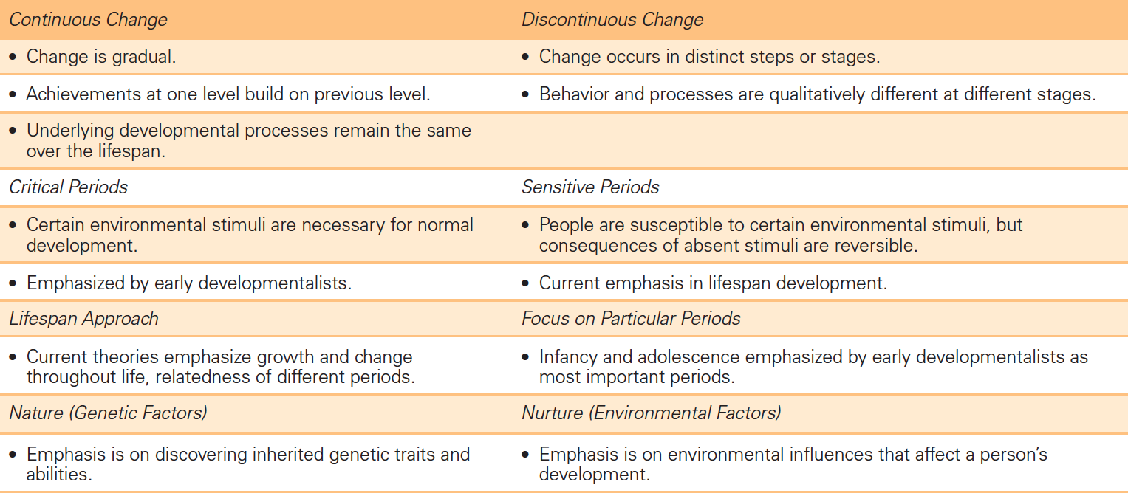
Table 1-2. Major Issues in Lifespan Development

Slide 19
Review and Apply
APPLY
What are some examples of the ways culture (either broad culture or aspects of culture) affects human development?
How might your professor's cohort membership affect the way this class is taught?
How might YOUR cohort membership affect your readiness for and success in this class?
Notes:
Have a sense of humor about your own cohort. Students like knowing that you know you are in a different cohort.

Slide 20
THEORETICAL PERSPECTIVES

Slide 21
What is a theory?
THEORY: broad, organized explanations and predictions concerning phenomena of interest.
How do ‘theories’ relate to Development?
Which theoretical perspectives have guided lifespan development?
Notes:
(See Table 1-3 for an example of Freud's and Erikson's theories)
Ask: Do you have a theory of development? Students may be reluctant to answer. Tell an outlandish story about yourself or your family. For example, you may report that your 2 year old drove you to class today or that you just won a US championship for speed skating. Amidst smiles and giggles, suggest that such things are humorous because students recognize that they are implausible. Why? What basic (often unrefined and unsophisticated) ideas have students drawn about what people can and cannot do at certain ages? Where does this information come from? In fact, these are rudimentary, personal theories about general development. How are these theories different from the ones studied in this chapter? In what ways can BOTH kinds of theories be used to understand development?
Ask: How are these personal theories different from developmentalists’ theories?

Slide 22
What theories will we explore?
There are 6 major perspectives:
Psychodynamic
Behavioral
Cognitive
Humanistic
Contextual
Evolutionary
Notes:
HINT: Use Table 1-3 as a guide
Discuss the difference among perspectives, approaches, and theories.
How do these affect how lifespan development is perceived and acted upon?

Slide 23
Each of these theories are closely linked to one or more theorists:
Theory | Theorist
Psychodynamic | Freud Erikson
Behavioral | Pavlov (omitted by textbook) Watson Skinner
Cognitive | Piaget Neo-Piagetians
Humanistic | Rogers Maslow
Contextual | Bronfenbrenner Vygotsky
Evolutionary | Darwin Lorenz*
* I think the author/developmental psychologists miscategorize Lorenz

Slide 24
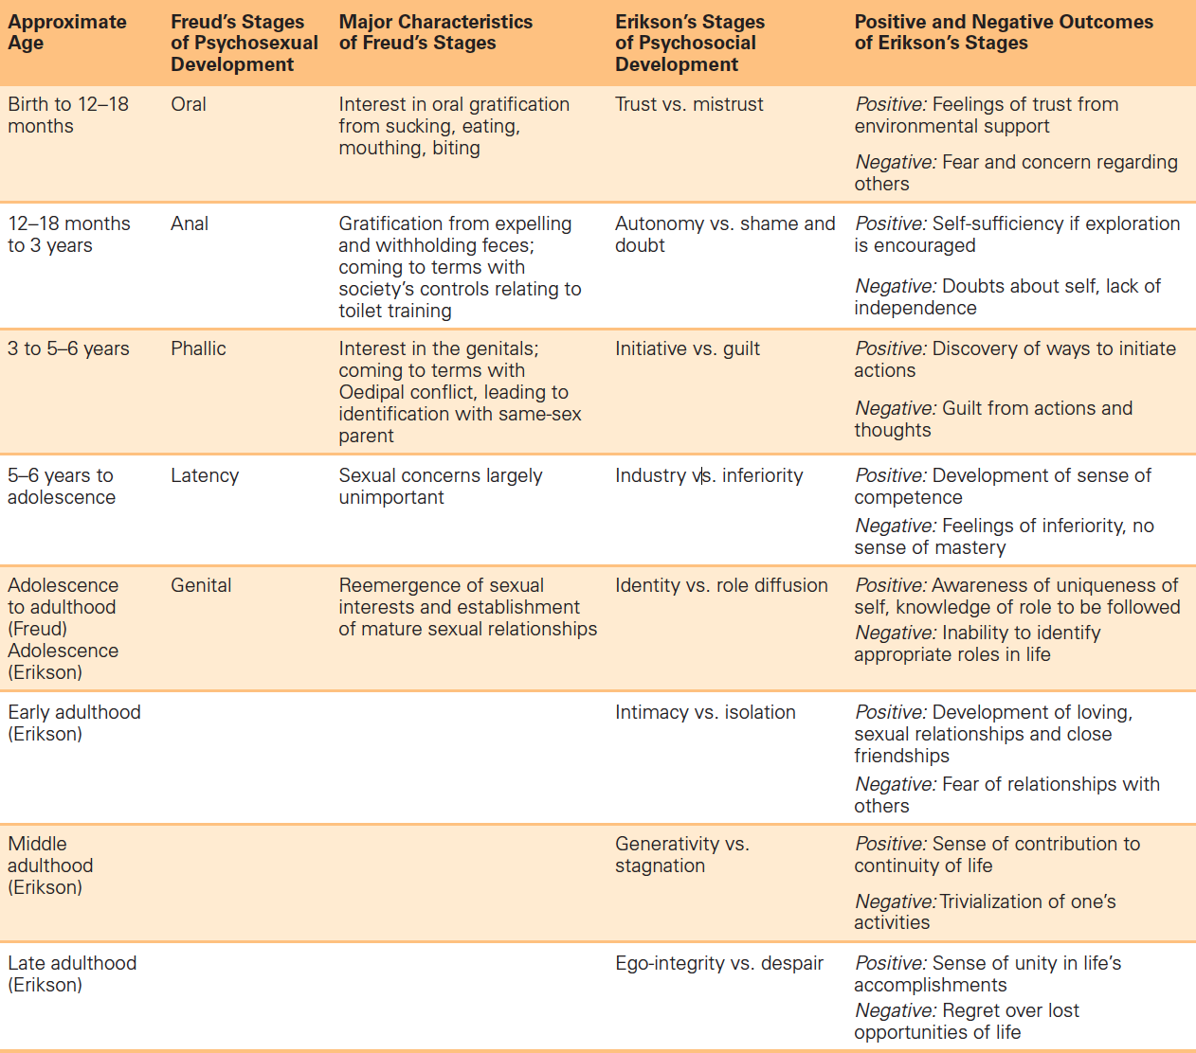
Complete Example
Freud's and Erikson's Theories
Table 1-3

Slide 25
Perspectives, Theories, and Approaches
Second, we can match theories and approaches with each perspective:
Psychodynamic
  Psychoanalytic
  Psychosocial
Behavioral
  Classical Conditioning
  Operant Conditioning
  Social-Cognitive Learning
Notes:
Each perspective:
emphasizes somewhat different aspects of development
steers developmentalists in particular directions
continues to evolve and change

Slide 26
Perspectives, Theories, and Approaches (continued)
Cognitive
  Information Processing
  Cognitive Neuroscience
Humanistic
Contextual
  Bioecological
  Sociocultural
Evolutionary

Slide 27
Overwhelmed?
Let's organize all this information into workable pieces!

Slide 28
The Text uses “theory maps” that contain the following sections:
Perspective
Theory
Theorist
What develops
How development proceeds
Principles
Key terms
Notes:
Maps can be distributed for students to complete, completed with input from class, or presented in pre-completed format.

Slide 29
Psychodynamic Theory Map – 1/2
Perspective
Theory
Theorist
What develops
How development proceeds
Principles
Personality has three aspects-id, ego, and superego
Psychosexual development involves series of stages-oral, anal, phallic, genital
Other key terms
Psychodynamic
Psychoanalytic Theory
Freud
Focus on inner person, unconscious forces act to determine personality and behavior
Behavior motivated by inner forces, memories, and conflicts
Pleasure principle, reality principle, fixation

Slide 30
Psychodynamic Theory Map 2/2
Perspective
Psychodynamic
Theory
Psychosocial Theory
Theorist
Erikson
Primary focus
How development proceeds
Development occurs through changes in interactions with and understanding of others and in self knowledge and understanding of members of society
Principles
Psychosocial development involves eight distinct, fixed, universal stages.
Each stage presents crisis/conflict to be resolved; growth and change are lifelong
Other key terms
trust vs. mistrust, autonomy vs. shame and doubt, initiative vs. guilt, industry vs. inferiority, identity vs. role diffusion, intimacy vs. isolation, generativity vs. stagnation, ego-integrity vs. despair
Focus on social interaction with others

Slide 31
Psychodynamic Perspective: Assessing
Widely Accepted
FREUD
Notion of unconscious influences accepted by many
ERIKSON
Notion of development throughout lifespan receives considerable support
Widely Questioned or Rejected
FREUD
Effects of childhood stages on later development not validated
Generalizability to broader, multicultural populations not supported
Primary focus on male development criticized
ERIKSON
More focus on men than women
Vague and difficult to test rigorously in some parts
Notes:
Slogan for Psychodynamic Perspective: “Good past behavior described; imprecise future predicted”

Slide 32
Behavioral Theory Map 1/3
Perspective
Behavioral
Theorist
John B. Watson
What develops
Focus on observable behavior and outside environmental stimuli
How development proceeds
Behavior is result of continuing exposure to specific environmental factors; developmental change is quantitative
Principles
Classical conditioning
Other key terms
Stimulus substitution; conditioned automatic response
Notes:
Define: CLASSICAL CONDITIONING

Slide 33
Behavioral Theory Map 2/3
Perspective
Behavioral
Theorist
B. F. Skinner
What develops
Focus on observable behavior and outside environmental stimuli
How development proceeds
Voluntary response is strengthened or weakened by association with negative or positive consequences
Principles
Operant conditioning
Other key terms
Deliberate actions on environment; behavior modification; reinforcement; punishment; extinguished behavior
Notes:
Define: CLASSICAL CONDITIONING

Slide 34
Behavioral Theory Map 3/3
Perspective
Behavioral
Theorist
Albert Bandura and colleagues
What develops
Focus on learning through imitation
How development proceeds
Behavior is learned through observation
Principles
Social-cognitive learning occurs through four steps: attend/perceive, recall, accurately reproduce, motivated to carry out behavior
Other key terms
Model; reward; “Fearless Peter”
Notes:
Define: CLASSICAL CONDITIONING

Slide 35
Behavioral Perspective: Assessing
Widely Accepted
WATSON AND SKINNER
Based on observable behaviors that are easier to quantify in research
Contributions to educational techniques for children with severe mental retardation
Widely Questioned or Rejected
WATSON AND SKINNER
Social learning theorists suggest oversimplification
Behaviorism does not account for free will, internal influences (e.g., moods, thoughts, feelings), or other types of learning
Notes:
Slogan for Psychodynamic Perspective: “Good past behavior described; imprecise future predicted”

Slide 36
Cognitive Theory Map 1/3
Perspective
Cognitive perspective
Theorist
Jean Piaget
What develops
Focus on processes that allow people to know, understand, and think about the world
How development proceeds
Human thinking is arranged in organized mental patterns that represent behaviors and actions; understanding of world improves through assimilation and accommodation
Principles
Classical conditioning
Other key terms
Schemes and schemas
Notes:
Define:
ASSIMILATION- process in which people understand an experience in terms of current stage of cognitive development and way of thinking
ACCOMMODATION- changes in existing ways of thinking in response to encounters with new stimuli or events

Slide 37
Cognitive Theory Map 2/3
Perspective
Cognitive perspective
Theorist
Information-processing approach
What develops
Focus is primarily on memory
How development proceeds
Information is thought to be processed in serial, discontinuous manner as it moves from stage to stage (Stage theory model); information is stored in multiple locations throughout brain by means of networks of connections (connectionistic model)
Principles
Cognitive development proceeds quickly in certain areas and more slowly in others; experience plays greater role in cognition
Other key terms
Neo-Piagetian theory
Notes:
GENERAL PRINCIPLES:
Assumption of limited capacity of mental system
Control mechanism required to oversee processes (e.g., encoding, transformation, processing, storage, retrieval, utilization of information)
Two-way flow of information required to make sense of the world
Humans genetically prepared to process and organize information in specific ways

Slide 38
Cognitive Theory Map 3/3
Perspective
Cognitive perspective
Theorist
Cognitive neuroscience approach
What develops
Focus on cognitive development through lens of brain
How development proceeds
Approach considers internal, mental processes, but focuses specifically on the neurological activity that underlies thinking, problem solving, and other cognitive behavior
Principles
Associations between specific genes and wide range of disorders are identified
Other key terms
Autism; schizophrenia
Notes:
Define:
ASSIMILATION- process in which people understand an experience in terms of current stage of cognitive development and way of thinking
ACCOMMODATION- changes in existing ways of thinking in response to encounters with new stimuli or events

Slide 39
Cognitive Perspective: Assessing
Widely Accepted
PIAGET
Theory profoundly influenced understanding of cognition
Broad view of sequence of cognitive development is accurate
Widely Questioned or Rejected
PIAGET
Some specifics questions about changes in cognitive capabilities over time (e.g., timing of emerging skills)
Universality of stages has been disputed
Cultural differences in emergence of particular cognitive skills suggested
Growth is more continuous than proposed
Notes:
Slogan for Cognitive Perspective: “Good past behavior described; imprecise future predicted”

Slide 40
Cognitive Perspective: Assessing
Widely Accepted
INFORMATION-PROCESSING
Theory may currently be central part of understanding of development
Widely Questioned or Rejected
INFORMATION-PROCESSING
Theory does not offer complete explanation for behavior or address social context in which development takes place

Slide 41
Cognitive Approach: Assessing
Widely Accepted
COGNITIVE NEUROSCIENCE
New frontier in child and adolescent development
Approach offers important clues to appropriate treatments and fuller understanding of a range of developmental phenomena
Widely Questioned or Rejected
COGNITIVE NEUROSCIENCE
Approach sometimes provides a better description than explanation of developmental phenomena

Slide 42
Humanistic Theory Map 1/1
Perspective
Humanistic Perspective
Theorist
Carl Rogers; Abraham Maslow
What develops
Focus on each individual's ability and motivation to reach more advanced levels of maturity; people naturally seek to reach full potential
How development proceeds
Free of supernaturalism, approach recognizes human beings as a part of nature and holds that values (religious, ethical, social, or political) have their source in human experience and culture
Principles
All people have need for positive regard resulting from underlying wish to be loved and respected; positive regard comes from others
Other key terms
Free will; positive self-regard; self-actualization
Notes:
BACKGROUND:
Explicitly concerned with the human dimension of psychology and the human context for the development of psychological theory
SELF-ACTUALIZATION is a state of self-fulfillment in which people achieve their highest potential in their own unique way; a primary goal in life
Approach has roots in existentialist thought which claims humans create the meaning in their own lives

Slide 43
Humanistic Perspective: Assessing
Widely Accepted
HUMANISTIC PERSPECTIVE
Some concepts (e.g., self-actualization) help describe important aspects of human behavior
Humanistic influences seen in wide range of areas from health care to business
Widely Questioned or Rejected
HUMANISTIC PERSPECTIVE
No clear, major impact on field of lifespan development due to lack of identification of broad developmental change that is the result of increasing age or experience

Slide 44
Contextual Theory Map
Perspective
Contextual Perspective
Theorist
Urie Bronfenbrenner/Bioecological Approach
What develops
Focus relationship between individuals and their physical, cognitive, personality, and social worlds
How development proceeds
Development is unique and intimately tied to person's social and cultural context; four levels of environment simultaneously influence individuals
Principles
Each system contains roles, norms, and rules that can powerfully shape development
Other key terms
Microsystem; ecosystem; exosystem; macrosystem; chronosystem
Notes:
The four systems:
MICROSYSTEM: Immediate environments (family, school, peer group, neighborhood, and childcare environments)
MESOSYSTEM: A system comprised of connections between immediate environments (i.e., a child's home and school)
EXOSYSTEM: External environmental settings which only indirectly affect development (such as parent's workplace)
MACROSYSTEM: The larger cultural context (Eastern vs. Western culture, national economy, political culture, subculture)
Later a fifth system was added:
CHRONOSYSTEM: The patterning of environmental events and transitions over the course of life.

Slide 45
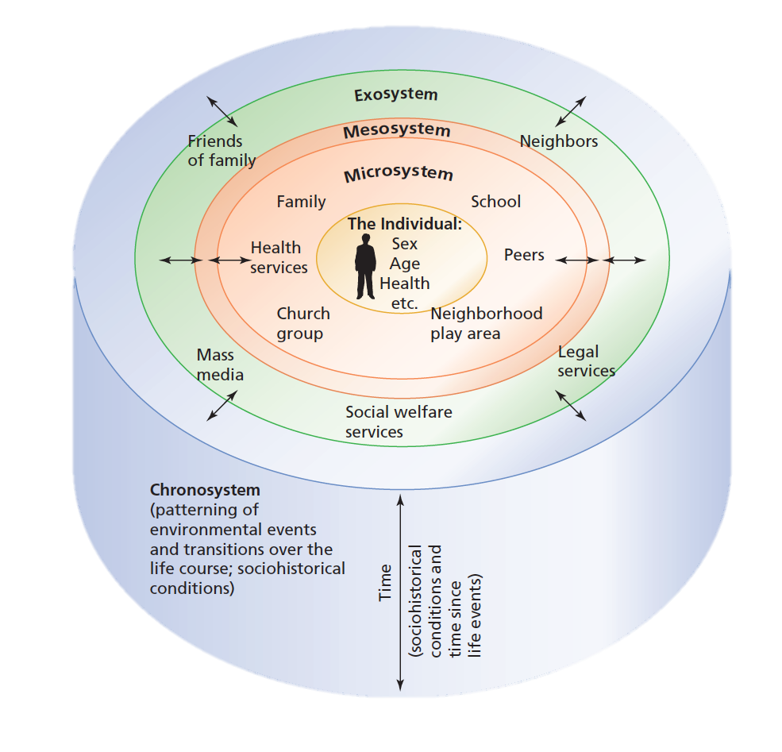
Bioecological Approach to Development
Macrosystem
Notes:
Figure 1-2. Bronfenbrenner's Approach to Development
Urie Bronfenbrenner’s bioecological approach
to development offers five levels of the environment
that simultaneously influence individuals:
the macrosystem, exosystem, mesosystem,
and microsystem.

Slide 46
Bioecological Approach: Assessing
Widely Accepted
BIOECOLOGICAL PERSPECTIVE
Perspective helped generate much research
Suggestion of mutual accommodation between the developing individual and the environment affects children's develop is of considerable importance to child development
Widely Questioned or Rejected
BIOECOLOGICAL PERSPECTIVE
Some argue that perspective pays insufficient attention to biological factors
Difficult to test for “neighborhood” effects

Slide 47
Contextual Theory Map
Perspective
Sociocultural Perspective
Theorist
Lev Vygotsky
What develops
As children play and cooperate with others, they learn what is important in their society and advance cognitively in their understanding of world
How development proceeds
Approach emphasizes how cognitive development proceeds as a result of social interactions between members
Principles
Development is a reciprocal transaction between people in the child's environment and the child.
Other key terms
Social interactions, zone of proximal development (ZPD), interpsychological and intrapsychologial levels
Notes:
BACKGROUND:
Explicitly concerned with the human dimension of psychology and the human context for the development of psychological theory
SELF-ACTUALIZATION is a state of self-fulfillment in which people achieve their highest potential in their own unique way; a primary goal in life
Approach has roots in existentialist thought which claims humans create the meaning in their own lives

Slide 48
Sociocultural Approach: Assessing
Widely Accepted
SOCIOCULTURAL PERSPECTIVE
One of first developmentalists to recognize importance of culture
Perspective becoming increasingly influential with growing acknowledgement of central importance of cultural factors in development
Widely Questioned or Rejected
SOCIOCULTURAL PERSPECTIVE
Some argue that emphasis on role of culture and social experience presented at expense of focus on effects of biological factors on development
Approach minimizes role individuals play in shaping own environment

Slide 49
Evolutionary Theory Map 1/1
Perspective
Evolutionary Perspective
Theorist
Charles Darwin/Konrad Lorenz
What develops
Through a process of natural selection traits in a species that are adaptive to its environment are creative
How development proceeds
Behavior is result of genetic inheritance from ancestors
Principles
Ethological influence (examines ways in which biological makeup affects behavior)
Other key terms
Behavioral genetics; relationship to psychological disorders (e.g., schizophrenia)
Notes:
BACKGROUND:
Explicitly concerned with the human dimension of psychology and the human context for the development of psychological theory
SELF-ACTUALIZATION is a state of self-fulfillment in which people achieve their highest potential in their own unique way; a primary goal in life
Approach has roots in existentialist thought which claims humans create the meaning in their own lives

Slide 50
Evolutionary Approach: Assessing
Widely Accepted
EVOLUTIONARY PERSPECTIVE
Evolutionary approach is increasingly visible in field of lifespan development
Widely Questioned or Rejected
EVOLUTIONARY PERSPECTIVE
Some argue that perspective pays insufficient attention to environmental and social factors involved in producing children's and adults’ behavior
Experimental testing of theory is difficult

Slide 51
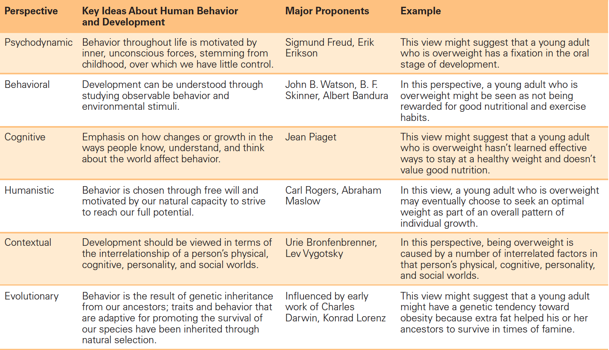
Major Perspectives on Lifespan Development

Slide 52
Which Approach is “Right”?

Slide 53
Why asking about right may be wrong…
Each perspective is based on its own premises and focuses on different aspects of development
Same developmental phenomenon can be examined from a number of perspectives simultaneously
None of the ‘theories’ are sufficient and complete. If they were there would be A Theory of Human Development.
Notes:
Psychodynamic approach emphasizes emotions, motivational conflicts, and unconscious determinants of behavior.
Behavioral perspectives emphasize overt behavior, paying far more attention to what people do than to what goes on inside their heads, which is deemed largely irrelevant.
Cognitive and humanistic perspectives take quite the opposite tack, looking more at what people think than at what they do.
Evolutionary perspective focuses on how inherited biological factors underlie development.

Slide 54
Review and Apply
APPLY
What examples of human behavior have you seen that seem as though they may have been inherited from our ancestors because they helped individuals survive and adapt more effectively?
Why do you think they are inherited?
Notes:
See page 29 in the text

Slide 55
RESEARCH METHODS

Slide 56
Now that we know what a theory is…how can theories be tested?
How are developmental research studies conducted?
Notes:
Define:
Theories: broad explanations, and predictions about phenomena of interests
Scientific methods: three major steps – identifying questions of interests; formulating an explanation; carrying out research that either supports or refutes

Slide 57
You should have learned all about this section in Introductory Psychology
Experimental Studies
Observational Studies
Hypotheses
Independent and dependent variables
Correlation
The Scientific Method
Notes:
Review content with class or prepare brief quiz on content.

Slide 58
The Scientific Method: Three Major Steps
Identifying questions of interest
Formulating an explanation
Carrying out research that either lends support to the explanation or refutes it
The Real Scientific Method: Five Major Steps
Identify a Research Problem
Design a Study
Collect and Analyze Data
Draw Conclusions
Communicate findings

Slide 59
Hypothesis
Can you think of a hypothesis related to grades assigned in this class?
How could your hypothesis be tested?
Notes:
Define:
Hypothesis: prediction stated in a way that permits it to be tested
A research strategy is needed to test a hypothesis

Slide 60
Categories of Research
Correlational research
Experimental research
Notes:
Define:
Correlational research: seeks to identify whether an association or relationship between two factors exists; CANNOT be used to determine whether one factor causes changes in the other—only association or relationship
Experimental research: seeks to discover causal relationships between various factors; change introduced in a carefully structured situation to see consequences of that change

Slide 61
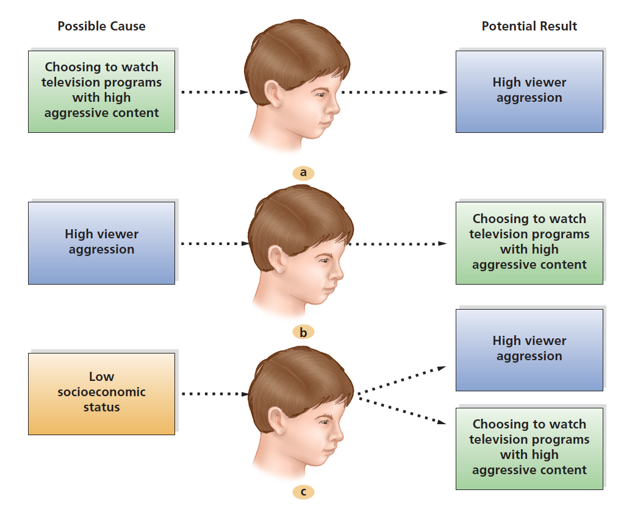
Correlational Studies
(I’d put “study” in quotes)
Notes:
Finding a correlation between two factors does not imply that one factor causes the other factor to vary. For instance, suppose a study found that viewing television shows with high levels of aggression is correlated with actual aggression in children. The correlation may reflect at least three possibilities: (a) watching television programs containing high levels of aggression causes aggression in viewers; (b) children who behave aggressively choose to watch TV programs with high levels of aggression; or (c) some third factor, such as a child’s socioeconomic status, leads both to high viewer aggression and to choosing to watch television programs with high levels of aggression. What other factors, besides socioeconomic status, might be plausible third factors?

Slide 62
Correlational Thinking Examples
People killed ∩ guns => guns kill people => ban guns to stop killings
  Sequential error
  Cherry picked correlation (alcohol, insanity, gun user)
Blacks ∩ high incarceration rate => all blacks are criminals
  Generalization error
Old people ∩ dementia => old people mentally impaired
  Generalization error

Slide 63
Correlational Studies
Remember: Correlations
Do not prove causality
May provide important information
  Chronological order important
  Reliability & Frequency important
Are often misused by lawyers & politicians
Can mislead you into incorrect beliefs & judgment errors
Correlation Coefficient
Strength and direction of relationship between two factors represented by mathematical score: range from +1.0 to -1.0
Notes:
Although it is possible that the variables are linked causally, this is not necessarily the case.
Important information examples:
The closer the genetic link between two people, the more highly associated is their intelligence.
The more parents speak to their young children, the more extensive are the children's vocabularies.
The better the nutrition that infants receive, the fewer the cognitive and social problems they experience later.
Define:
Correlation Coefficient: mathematical score ranging from +1.0 to -1.0 that denote strength and direction of relationship between two factors
+ correlation = when value of one factor increases it can be predicted that the value of the other will also increase
- correlation = when value of one factor decreases it can be predicted that the value of the other will also decrease
0 correlation = two factors are unrelated to one another

Slide 64
Types of Correlational Studies
Naturalistic observation
Ethnography and qualitative research
Case studies – big with MBAs
Diaries – used by therapists
Survey research – Market Research, Political Polls
Psychophysiological methods
Electroencephalogram (EEG) - Psychologists
Computerized axial tomography (CAT) scan – lots of folks
Functional magnetic resonance imaging (fMRI) scan -ditto
Notes:
Naturalistic observation
Observe/study in natural context or habitat
Does not allow for control over factors of interest
Ethnography
Uses to investigate cultural questions
Researcher serves as participant observer
Does not control for researcher bias; generalizability may be difficult
Case studies
Used with individual or small group to derive broader principles or tentative conclusions
Diaries
Survey research
Used with group chosen to represent larger population
Inferences drawn from responses
Psychophysiological methods
Focus on relationship between physiological processes and behavior
Used in cognitive neuroscience
EEG, CAT scan, fMRI
Among the most frequently used psychophysiological measures:
Electroencephalogram (EEG). The EEG records electrical activity within the brain recorded by electrodes placed on the outside of the skull. That brain activity is transformed into a pictorial representation of the brain, permitting the representation of brain wave patterns and diagnosis of disorders such as epilepsy and learning disabilities.
Computerized axial tomography (CAT) scan. In a CAT scan, a computer constructs an image of the brain by combining thousands of individual x-rays taken at slightly different angles. Although it does not show brain activity, it does illuminate the structure of the brain.
Functional magnetic resonance imaging (fMRI) scan. An fMRI provides a detailed, three-dimensional computer-generated image of brain activity by aiming a powerful magnetic field at the brain. It offers one of the best ways of learning about the operation of the brain, down to the level of individual nerves.

Slide 65
Determining Cause and Effect
Experiment
Groups
  Treatment/experimental
  Control
Variables
  Independent
  Dependent
Random subject selection and assignment
Notes:
Define:
Experiment: investigator typically devises two different conditions (treatments) and studies/compares outcomes of participants exposed to those two different conditions to see how behavior is affected
Groups:
Treatment/experimental group: exposed to treatment variable being studied
Control group: not studied
Variables
The independent variable is the variable that researchers manipulate in the experiment (in our example, it is the type of movie participants saw – violent or non-violent).
The dependent variable is the variable that researchers measure in an experiment and expect to change as a result of the experimental manipulation.

Slide 66
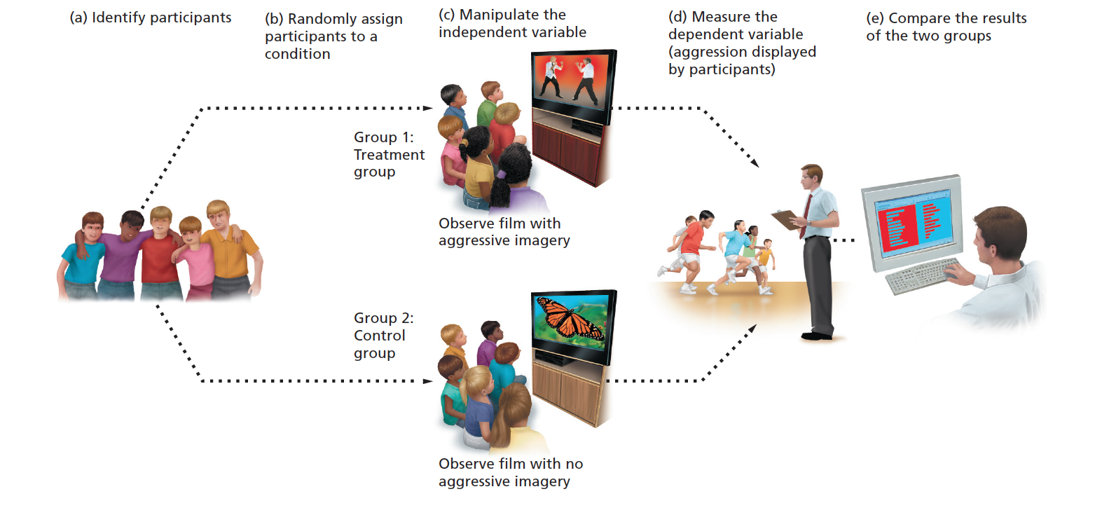
Elements of An Experiment
Notes:
In this experiment, researchers randomly assigned a group of adolescents to one of two conditions: viewing a film that contained violent
imagery, or viewing a film that lacked violent imagery (manipulation of the independent variable). Participants were observed later
to determine how much aggression they showed (the dependent variable). Analysis of the findings showed that adolescents exposed
to aggressive imagery showed more aggression later.
(Based on an experiment by Leyens et al., 1975.)

Slide 67
Choosing Research Settings
Field study
Capture behavior in real-life settings
Participants may behave more naturally
May be used in correlational studies and experiments
Often difficult to exert control over situation and environment
Notes:
Define:
Field study is a research investigation carried out in a naturally occurring setting.
Laboratory study is a research investigation conducted in a controlled setting explicitly designed to hold events constant.

Slide 68
Choosing Research Settings
Laboratory study
Hold events constant
Enables researchers to learn more clearly how treatment affect participants
Notes:
Define:
Field study is a research investigation carried out in a naturally occurring setting.
Laboratory study is a research investigation conducted in a controlled setting explicitly designed to hold events constant.

Slide 69
So…true or false?
A hypothesis predicts how dependent variables depends on the manipulation of the independent variable.
Notes:
True

Slide 70
Why aren’t experiments always used?
Logically impossible
  Using information from the future
Ethically impossible
  Permanent injury to a person
Financially impossible
  Moving residents apartments to other floors
Socially impossible
  Assigning students to classes based on income
Temporally impossible
  Asking dead people questions
Notes:
Some situations cannot be controlled.
Sometimes control would be unethical.

Slide 71
Complementary Approaches
Theoretical research
  Investigate an idea
  Advance scientific knowledge
Applied research
  Practical solution
  Immediate problem
Applied research is often viewed by ‘scientists’ as vulgar, suspect because of funding sources, and of lesser intrinsic value.
Notes:
Define:
Theoretical research is designed specifically to test some developmental explanation and expand scientific knowledge.
Applied research is meant to provide practical solutions to immediate problems.
Even the most applied research can help advance our theoretical understanding of a particular topical area, and theoretical research can provide concrete solutions to a range of practical problems.

Slide 72
From Research to Practice in Theory
Using Developmental Research to Improve Public Policy
Research findings can provide policymakers a means of determining what questions to ask in the first place.
Research findings and the testimony of researchers are often part of the process by which laws are drafted.
Policymakers and other professionals use research findings to determine how best to implement programs.
Research techniques are used to evaluate the effectiveness of existing programs and policies.

Slide 73
From Research to Practice in Reality
Using Developmental Research to Improve Public Policy
Research findings can provide policymakers a means of limiting questions and discussion.
  Questioning ‘Global Warming’ is not allowed
Research findings and the testimony of researchers are often part of the process by which laws are justified.
  Head Start simply has no lasting effect
Policymakers and other professionals use research findings to justify giving money to cronies or the politically connected.
  MIT & Harvard disproportionally gets federal funding
Research techniques are used to fake the effectiveness of existing programs and policies.
  Pseudoscience is rife in government and legal circles

Slide 74
Consider this…
What are some policy issues affecting children and adolescents that are currently being debated nationally?
Despite the existence of research data that might inform policy about development, politicians rarely discuss such data in their speeches. Why do you think that is the case?

Slide 75
Measuring Developmental Change
Longitudinal Studies
Measuring individual change
Cross-Sectional Studies
Measuring people of different ages at same point in time
Sequential Studies
Notes:
Define:
Longitudinal research, the behavior of one or more study participants is measured as they age. Longitudinal research measures change over time; Terman IQ study; require significant investment of time; high attrition; test-wise participants
In cross-sectional research, people of different ages are compared at the same point in time. Cross-sectional studies provide information about differences in development between different age groups; cohort effects; selective dropout; unable to inform about changes in individuals or groups.
In sequential studies, researchers examine a number of different age groups at several points in time; a combination of longitudinal and cross-sectional studies; permits developmental researchers to tease out the consequences of age change versus age difference.

Slide 76
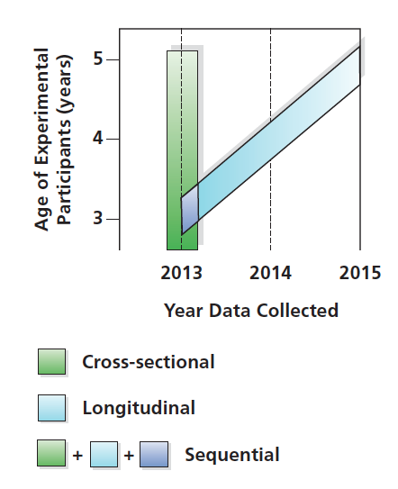
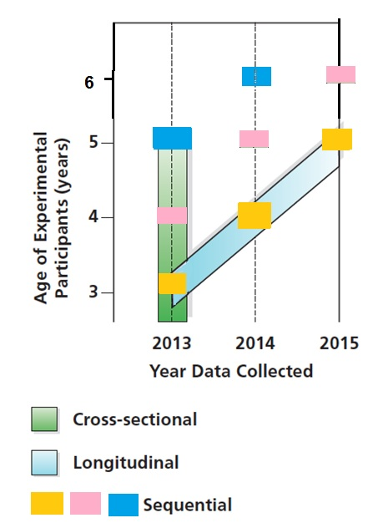
Use this figure to understand the benefits of a sequential design
Textbook figure is confusing
This figure is, hopefully, clearer.
Notes:
Figure 1-5 Research Techniques for Studying Development
In a cross-sectional study, three-, four-, and five-year-olds are compared at a similar point in time (in the year 2013). In longitudinal research, a set of participants who are three years old in 2013 are studied when they are four years old (in 2014) and when they are five years old (in 2015). Finally, a sequential study combines cross sectional and longitudinal techniques; here, a group of three-year-olds would be compared initially in 2013 with four- and five year- olds, but would also be studied one and two years later, when they themselves were four and five years old. Although the graph does not illustrate this, researchers carrying out this sequential study might also choose to retest the children who were four and five in 2013 for the next two years. What advantages do the three kinds of studies offer?

Slide 77
Ethics and Research
Ethical Guidelines for Researchers (SRCD)
Researchers must protect participants from
physical and psychological harm.
Researchers must obtain informed consent from
participants before their involvement in a study.
The use of deception in research must be justified
and cause no harm.
Participants’ privacy must be maintained.

Slide 78
Thinking Critically about “Expert” Advice
Who are the “experts” in your life?
What expert advice have you received about going to college?
Why (or why not) did you value or use this advice?
Notes:
Other advice:
If you immediately comfort crying babies, you’ll spoil them.
If you let babies cry without comforting them, they’ll be untrusting and clingy as adults.
If a marriage is unhappy, children are better off if their parents divorce than if they stay together.
No matter how difficult a marriage is, parents should avoid divorce for the sake of their children.

Slide 79
Becoming An Expert about Experts!
Consider the source.
Evaluate credentials.
Understand difference between anecdotal and scientific evidence.
Find details of research-based advice.
Do not overlook cultural context of information.
Recognize that popular consensus does not guarantee scientific validity.

Slide 80
Becoming An Expert about Experts!
Does ‘expert’ have an agenda?
Is there any remuneration to the ‘expert’?
Does the expert have a biase?
How does this expert opinion fit with other expert opinions?
Does the expert speak in jargon or clear English?
Who provided the expert’s credentials?
Was this expert ‘cherry picked’?

Slide 81
EPILOGUE
Before proceeding to the next chapter, take a few minutes to reconsider the prologue of this chapter—about Louis Brown, the first child to be born through in vitro fertilization. Based on what you now know about lifespan development, answer the following questions:
What are some questions that developmentalists who study either physical, cognitive, or personality and social development might ask about the effects on Louise of being conceived via in vitro fertilization?

Slide 82
EPILOGUE
Louise reported feeling lonely and isolated as a child. Why do you think this occurred, and what effects might it have on her as an adult?
Louise's own son was conceived in the traditional manner. How do you think his development will differ from that of his mother, Louise, and why?

